Slide 1
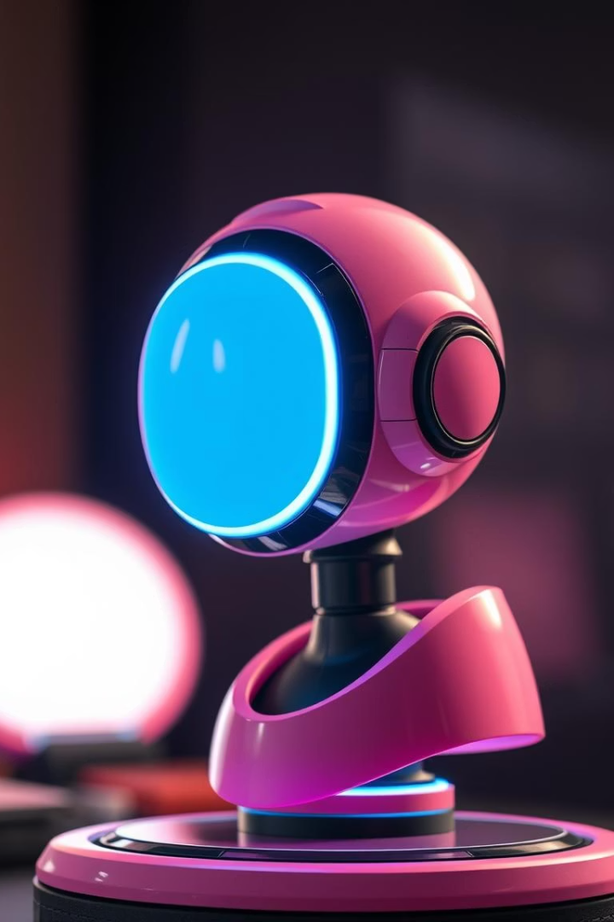

AI JARVIS: An Intelligent Voice Assistant
This presentation introduces AI JARVIS, a Python-based voice assistant.
Inspired by Iron Man's iconic assistant, JARVIS enables smart voice commands.

Slide 2

Project Overview
Goal
Create intelligent, voice-activated assistant software.
Technology
Built using Python for flexibility and power.
Speech Recognition
Converts spoken words to text for command processing.
Keyword Detection
Triggers actions based on voice commands.

Slide 3

Wake-Up and Listen Mechanism
Activation Phrase
Listening Mode
The assistant wakes when hearing "Hello Jarvis".
Listens actively for user commands post activation.
Voice Capture
Captures and processes spoken commands efficiently.

Slide 4
Core Technologies: Python and SpeechRecognition
Python
speech_recognition Library
Voice Interaction
Main language powering AI JARVIS's functions.
Transforms voice inputs into machine-readable text.
Enables real-time voice commands and responses.

Slide 5




Web Access Functionality
Command
Automation
Accessibility
"Open YouTube" triggers website launch.
Python automates browser actions seamlessly.
Users get quick web access by voice control.

Slide 6
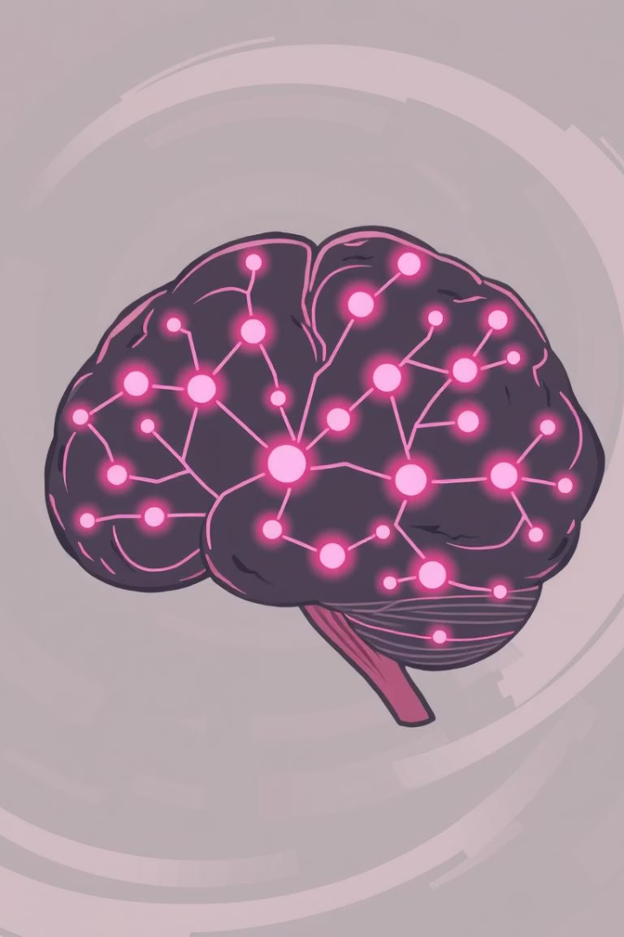



Advanced Features for Future Development
Natural Language Processing
Understanding complex commands better.
Machine Learning
Improving accuracy and personalizing responses.
IoT Integration
Voice control of smart home devices.

Slide 7

Demonstration of AI JARVIS
Website Launch
Voice Command
Assistant opens websites like YouTube instantly.
Wake-Up
User speaks instructions captured accurately.
Activation phrase triggers assistant readiness.

Slide 8
Conclusion and Future Scope
Summary
Future Plans
Next Steps
AI JARVIS handles voice commands and web tasks efficiently.
Integrate NLP, ML, and IoT for smarter responses.
Expand features and user interaction capabilities.

